Slide 1
CHAPTER 3:
Entity Relationship (ER) Modeling
DCI2033 – DATABASE SYSTEM

Slide 2
Learning Outcomes
Student should be able to:
  Describe the main characteristics of entity relationship components
  Describe business rules and how they influence database design
  Describe relationships between entities - defined, refined, and incorporated into the database design process
  Describe how ERD components affect database design and implementation
  Describe that real-world database design often requires the reconciliation of conflicting goals
Database Systems, 8th Edition

Slide 3
The Entity Relationship (ER) Model
What is ER Model ?
  Represents the conceptual database as viewed by the end user
  Depicted the database’s main components – entities, attributes, relationships
Database Systems, 8th Edition

Slide 4
HeadDept
MemberOf
Club
0..*
1..1
1
1..1
Lead
MemberOf
1
0..*
Department
Hire
Lecturer
Declare
Property
1
*
1..1
0..*
1
1..1
Sample of E-R Diagram for University of Engineering & Technology
(Attributes Not Shown)
Has
Teach
*
0..3
Student
Register
Course
Become
0..*
2..5
0..*
Prerequisite
0..2
Require

Slide 5
The Entity Relationship (ER) Model
Main components:
  Entities
  Attributes
  Relationships
Database Systems, 8th Edition

Slide 6
Entities
An object of interest to the end user
Refers to entity set and not to single entity occurrence
Often corresponds to table and not to row in relational environment
In Chen and Crow’s Foot models, entity represented by rectangle with entity’s name
Entity name : a noun, written in capital letters
Database Systems, 8th Edition

Slide 7
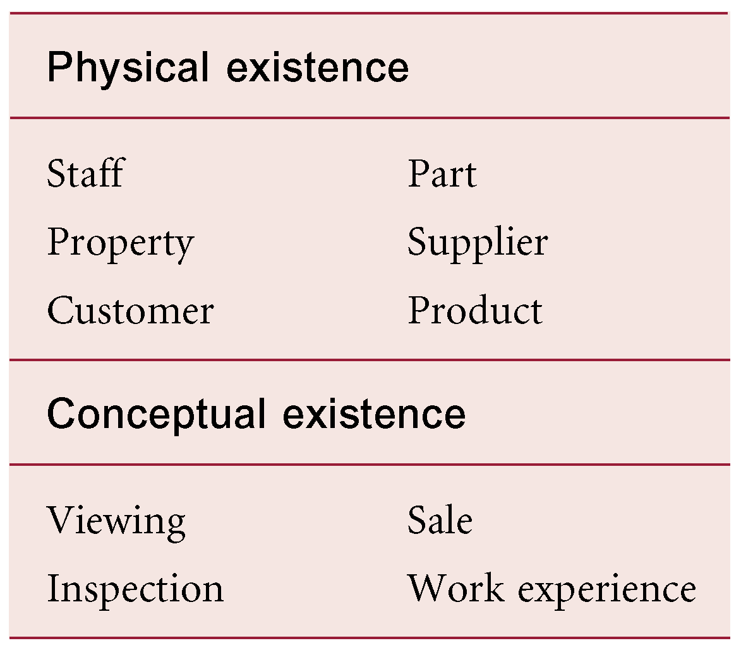

Example of entities
Entity Set symbol in E-R diagram

Slide 8
What should be an ENTITY?
SHOULD BE:
  An object that will have many instances in the database
  An object that will be composed of multiple attributes
  An object that we are trying to model
SHOULD NOT BE:
  A user of the database system
  An output of the database system (e.g., a report)

Slide 9
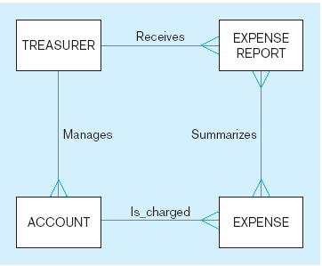
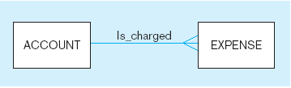
Example of inappropriate entities
System
user
System output
Appropriate entities

Slide 10
Entity Type
Strong Entity Type
  Entity type that is not existence-dependent on some other entity type
  Referred as parent, owner, or dominant entities
  has its own unique identifier
  identifier underlined with single-line
Weak Entity Type
  Entity type that is existence-dependent on some other entity type (cannot exist on its own)
  does not have a unique identifier (only a partial identifier)
  Referred to as child, dependent, or subordinate
© Pearson Education Limited 1995, 2005

Slide 11
Weak Entities
Weak entity meets two conditions
  Existence-dependent
    Cannot exist without the entity with which it has a relationship
  Primary key partially or totally derived from parent entity in relationship (strong/identifying relationship)
Database designer determines whether an entity is weak based on business rules
Database Systems, 8th Edition

Slide 12
Weak Entities
Example:
  A company insurance policy insures an employee and his/her dependents
  EMPLOYEE might or might not have a dependent, but the DEPENDENT must be associated with an EMPLOYEE
  the DEPENDENT cannot exist without the EMPLOYEE; a person cannot get insurance coverage as a dependent unless s(he) happens to be a dependent of an employee
  EMPLOYEE has DEPENDENT

Slide 13
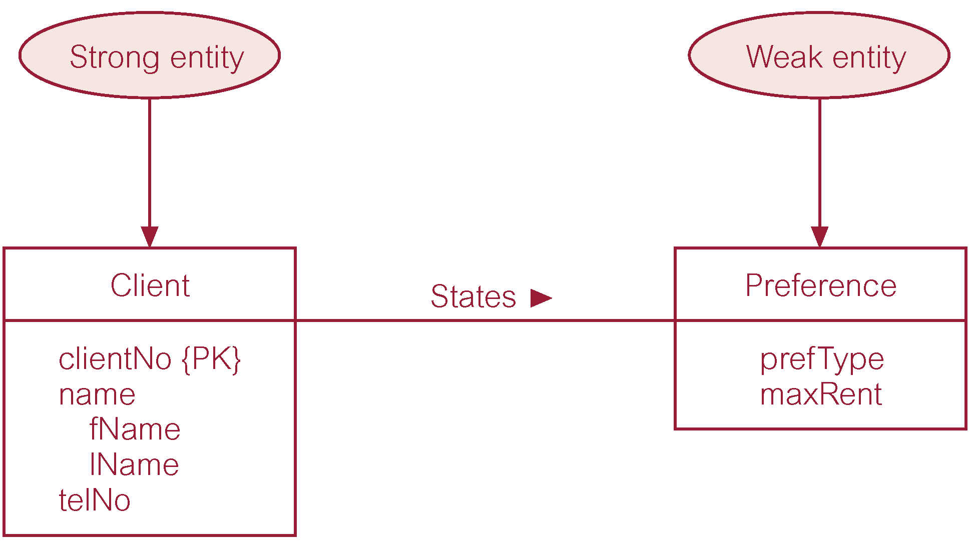
Strong entity type called Client and weak entity type called Preference
© Pearson Education Limited 1995, 2005

Slide 14
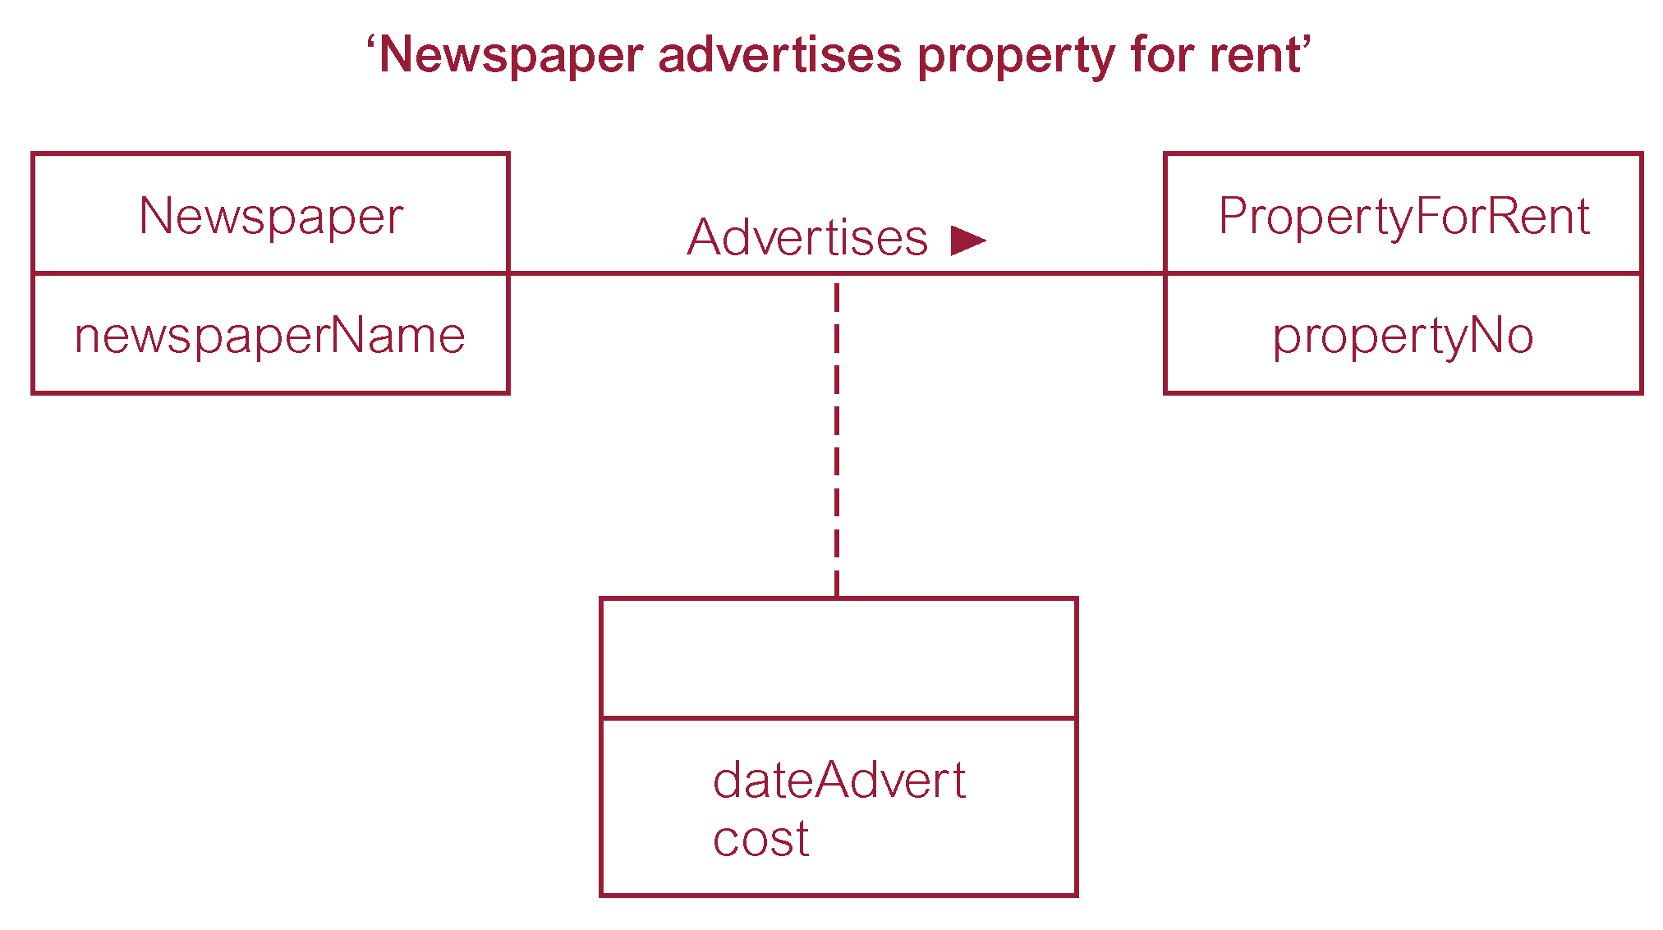
Relationship called Advertises with attributes
© Pearson Education Limited 1995, 2005

Slide 15
Attributes
Characteristics of entities
Property of an entity or a relationship type
Chen notation: attributes represented by ovals connected to entity rectangle with a line
  Each oval contains the name of attribute it represents
Crow’s Foot notation: attributes written in attribute box below entity rectangle
Database Systems, 8th Edition

Slide 16
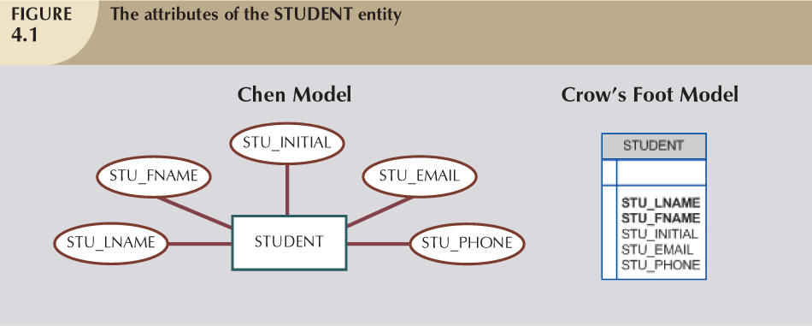
Attributes (2)
Database Systems, 8th Edition

Slide 17
Attributes (3)
Student
studentID(PK)
name
birthDate
address
homeNo
street
city
department
telNo [1..3]
/age
The Attributes in E-R Model

Slide 18
Attributes (4)
Required attribute: must have a value
Optional attribute: may be left empty
Domain: set of possible values for an attribute
  Attributes may share a domain
  E.g.: CGPA (0,4), Gender (F, M)
Database Systems, 8th Edition

Slide 19
Attributes (5)
STU_LNAME
STU_FNAME
Required Attribute
Optional Attribute
Database Systems, 8th Edition

Slide 20
Attributes (6)
Student
Required Attribute
studentID(PK)
name
birthDate
address
homeNo
street
city
department
telNo [1..3]
/age
Optional Attribute
The Attributes in E-R Model (UML Notation)

Slide 21
Attributes (7)
Identifiers (Primary Key): one or more attributes that uniquely identify each entity instance
Composite identifier: primary key composed of more than one attribute

Slide 22
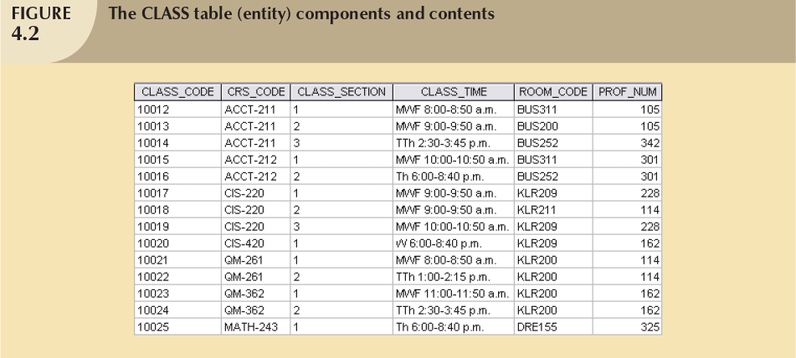
Attributes (8)
Identifier
Composite identifier
Database Systems, 8th Edition

Slide 23
Attributes (9)
Composite attribute :: can be subdivided
  E.g.: address can be subdivided into street, city, state, zip code
Simple attribute :: cannot be subdivided
  E.g.: age, gender
Single-value attribute :: can have only a single value
  E.g.: IC Number
Multivalued attributes :: can have many values
  E.g.: phone number
Database Systems, 8th Edition

Slide 24
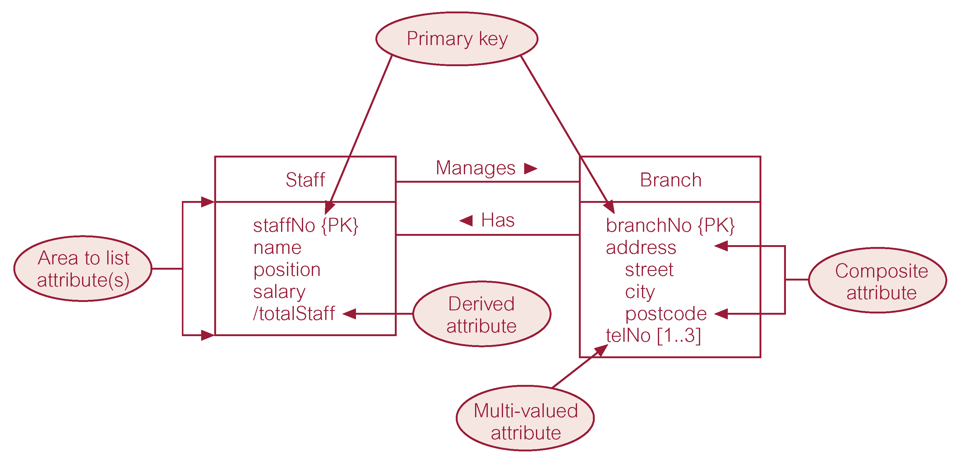

ER diagram of Staff and Branch entities and their attributes

Slide 25
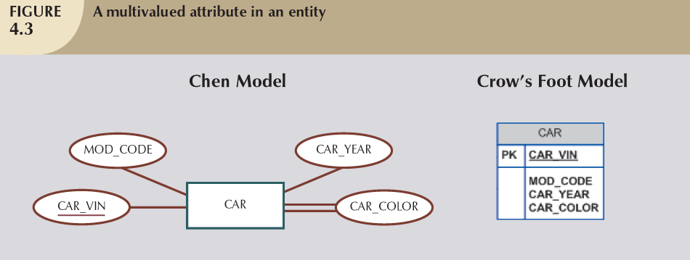
Attributes (9)
Primary Key
Multivalued attribute
Database Systems, 8th Edition

Slide 26
Attributes (10)
M:N relationships and multivalued attributes should not be implemented in RDBMS
  Create several new attributes for each of the original multivalued attributes components
  Create new entity composed of original multivalued attributes components
Derived attribute: value may be calculated from other attributes
  Need not be physically stored within database
Database Systems, 8th Edition

Slide 27
ER diagram of Staff and Branch entities and their attributes

Slide 28
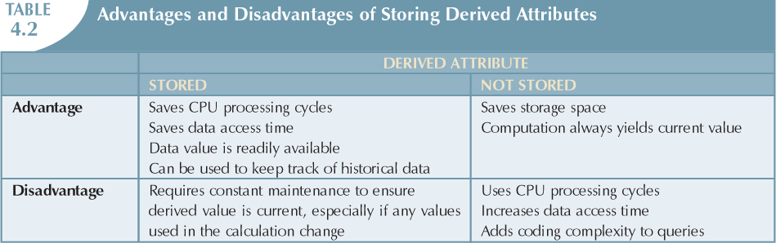
Database Systems, 8th Edition

Slide 29
Relationships
Association between entities
Participants :: entities that participate in a relationship
Relationships between entities always operate in both directions
Relationship name: active or passive verb (takes, teaches, employs, is managed by, is flown by)
Relationship classification is difficult to establish if only one side of the relationship is known
Database Systems, 8th Edition

Slide 30
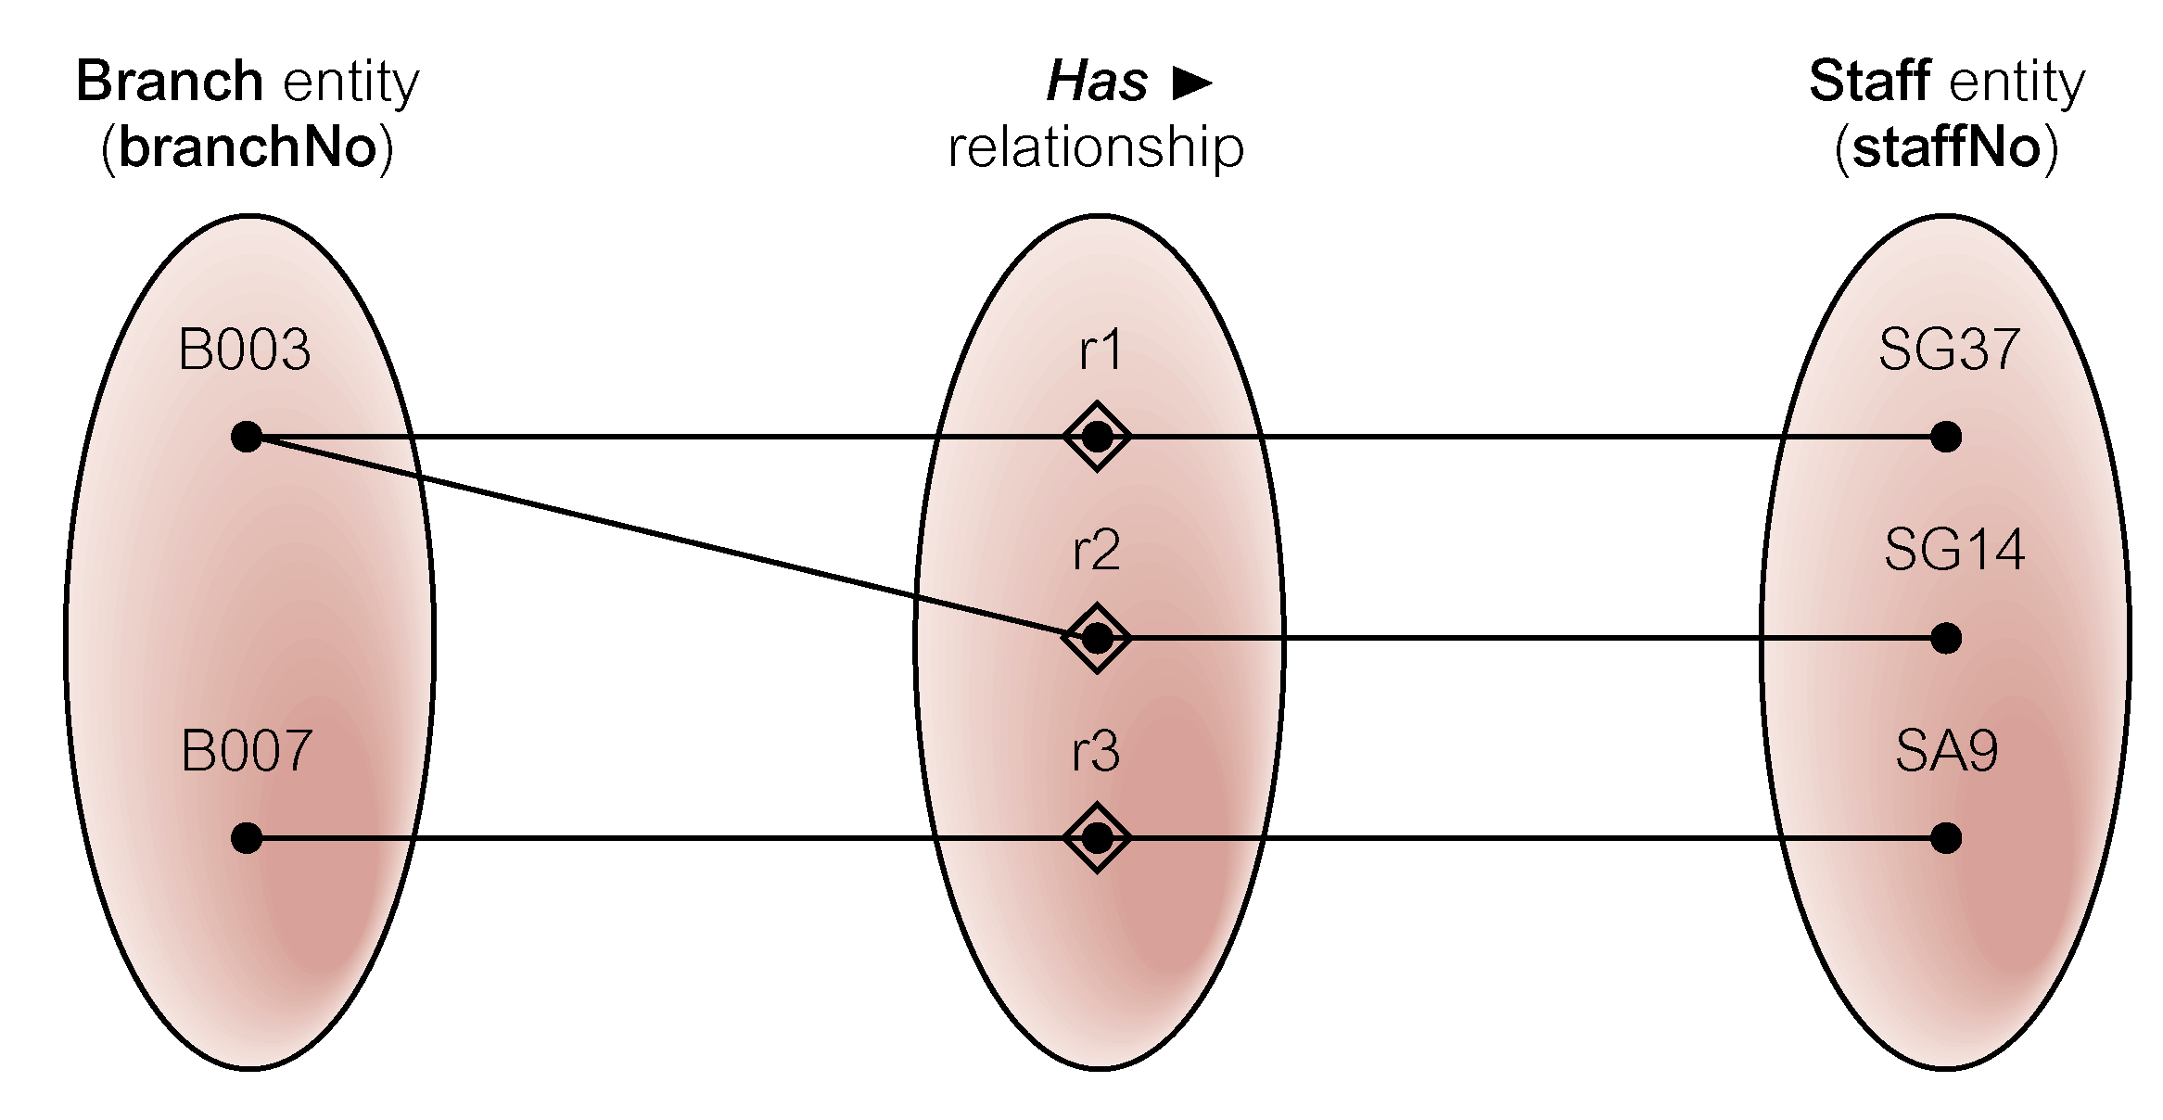
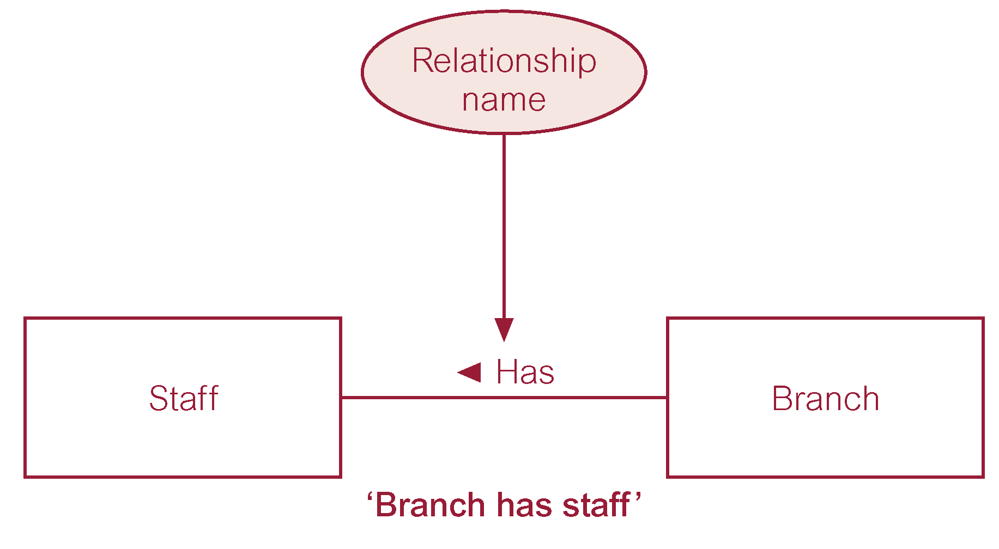
Semantic net of Has relationship type
ER diagram of Branch Has Staff relationship
© Pearson Education Limited 1995, 2005

Slide 31
Relationship Degree
Indicates number of entities or participants associated with a relationship
  Unary relationship / recursive relationship
    Association is maintained within single entity
  Binary relationship
    Two entities are associated
  Ternary relationship
    Three entities are associated
  Quaternary relationship
    Four entities are associated
Database Systems, 8th Edition

Slide 32

Relationship Degree
Course
require
becomes
NeedPrerequisite
Recursive Relationship in E-R diagram
Binary relationship called POwns

Slide 33
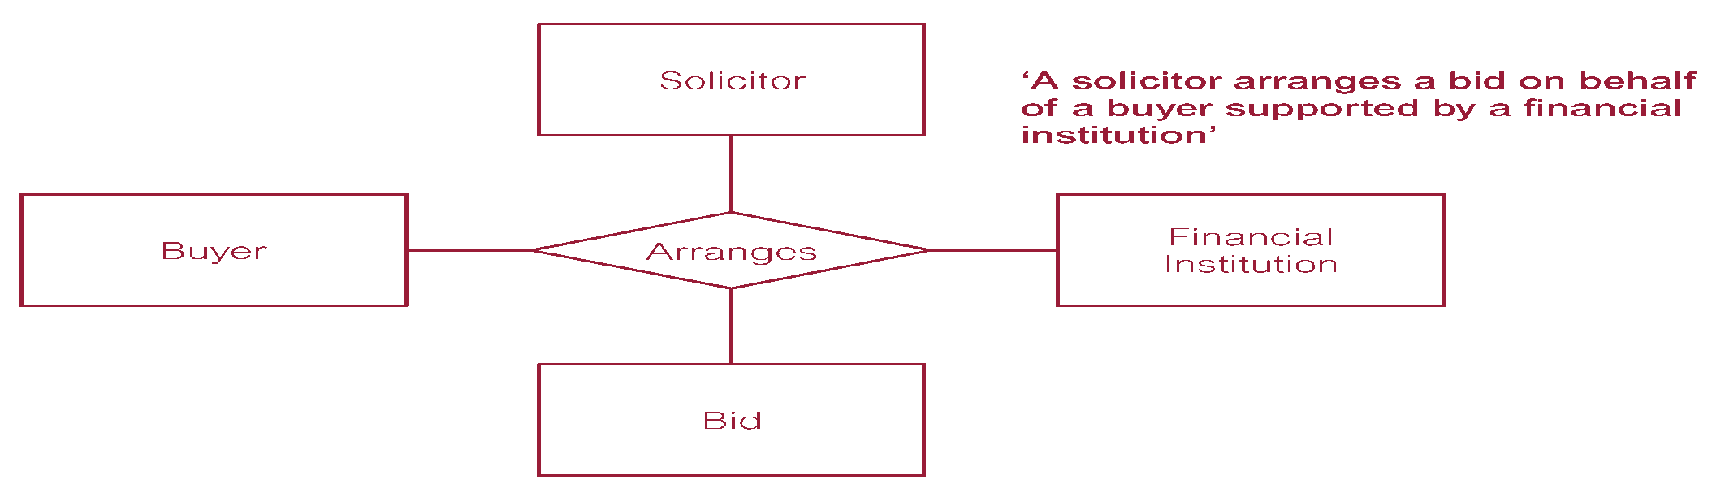
Relationship Degree
Lecturer
supervise
Student
Project
Ternary relationship called supervise
Quaternary relationship called Arranges

Slide 34
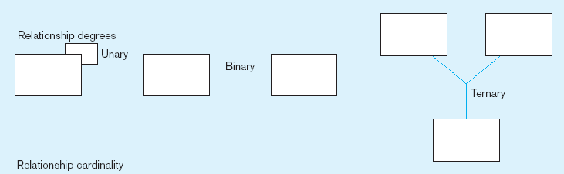
Relationship Degree
Entities of two different types related to each other
One entity related to another of the same entity type
Entities of three different types related to each other

Slide 35
Relationship constraints
Cardinality
  Expresses minimum and maximum number of entity occurrences associated with one occurrence of related entity
Multiplicity
  The cardinality of one entity that can relate to another entity’s cardinality via a set of relationship
Established by very concise statements known as business rules
Database Systems, 8th Edition

Slide 36
Relationship constraints
Multiplicity | Description
1 (or 1..1) * (or 0..*) 0..1 1..* n..m | One and only one Many (any number between zero and infinity) Whether zero or one One or many (any positive integer) Minimum n and maximum m

Slide 37
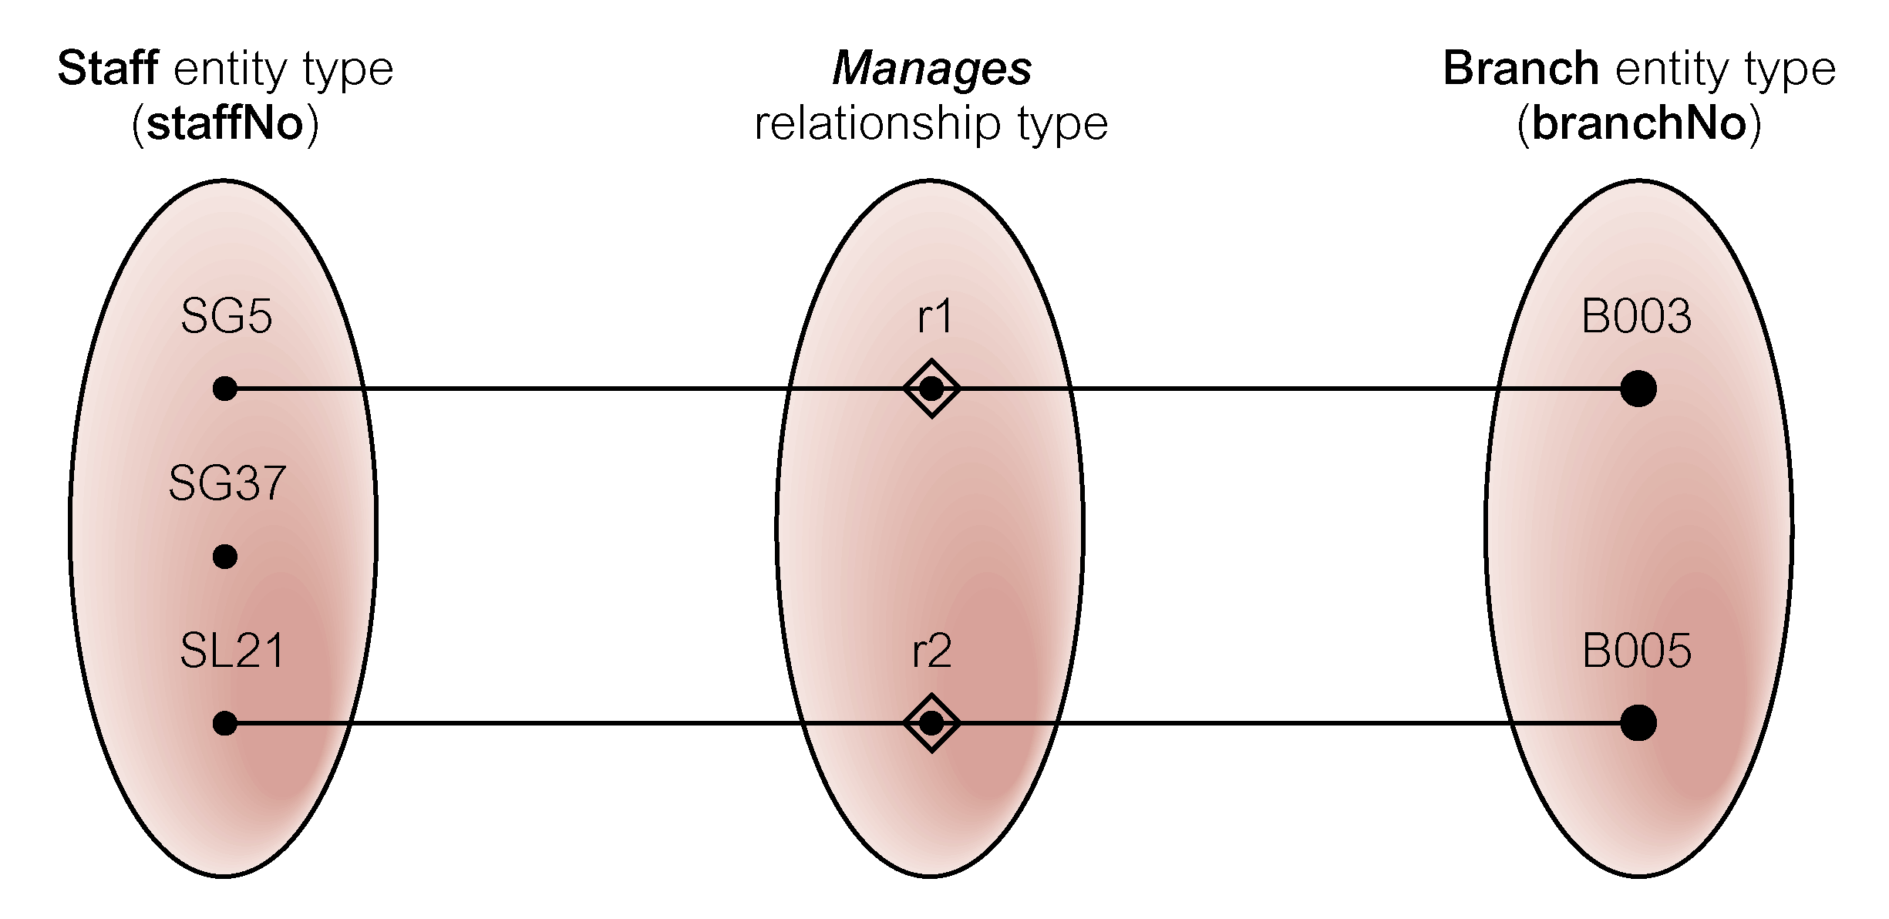
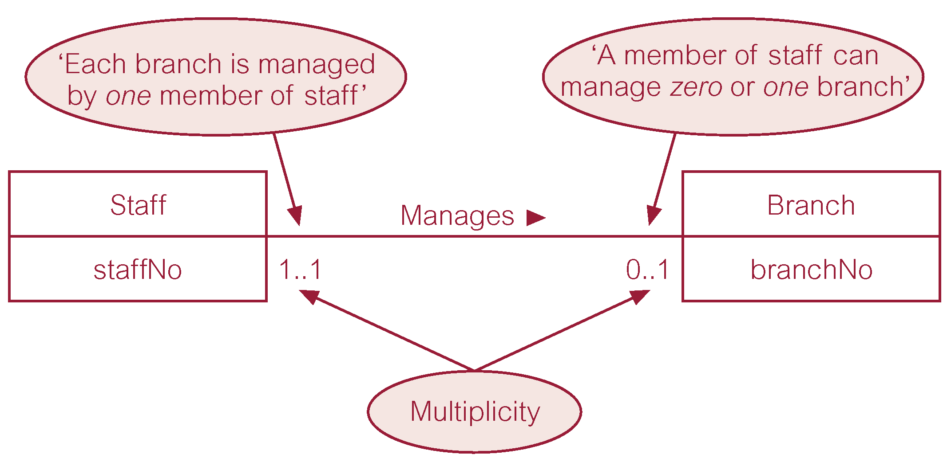
Semantic net of Staff Manages Branch relationship type
Multiplicity of Staff Manages Branch (1:1) relationship
© Pearson Education Limited 1995, 2005

Slide 38
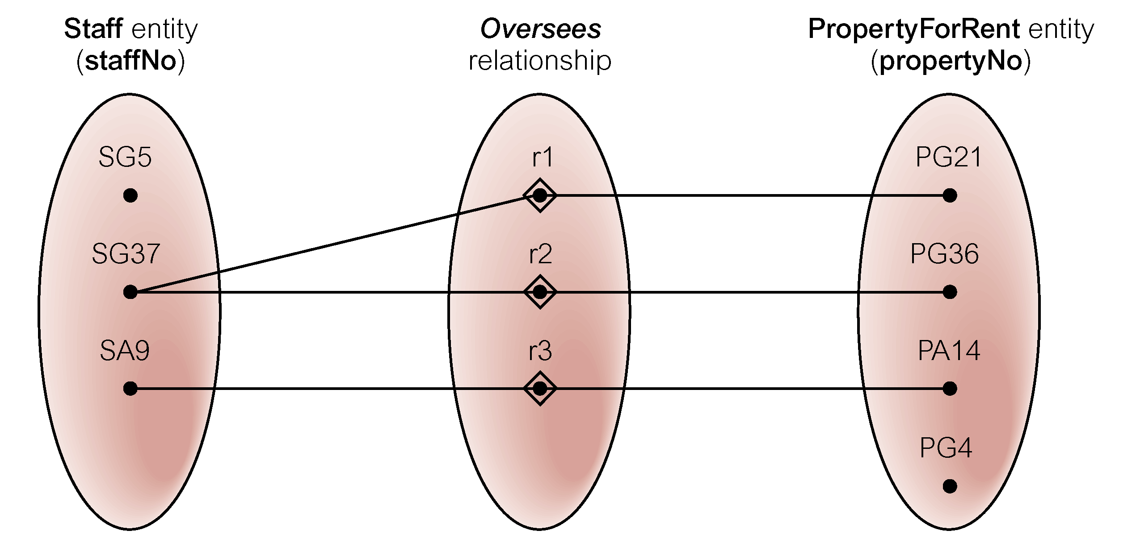
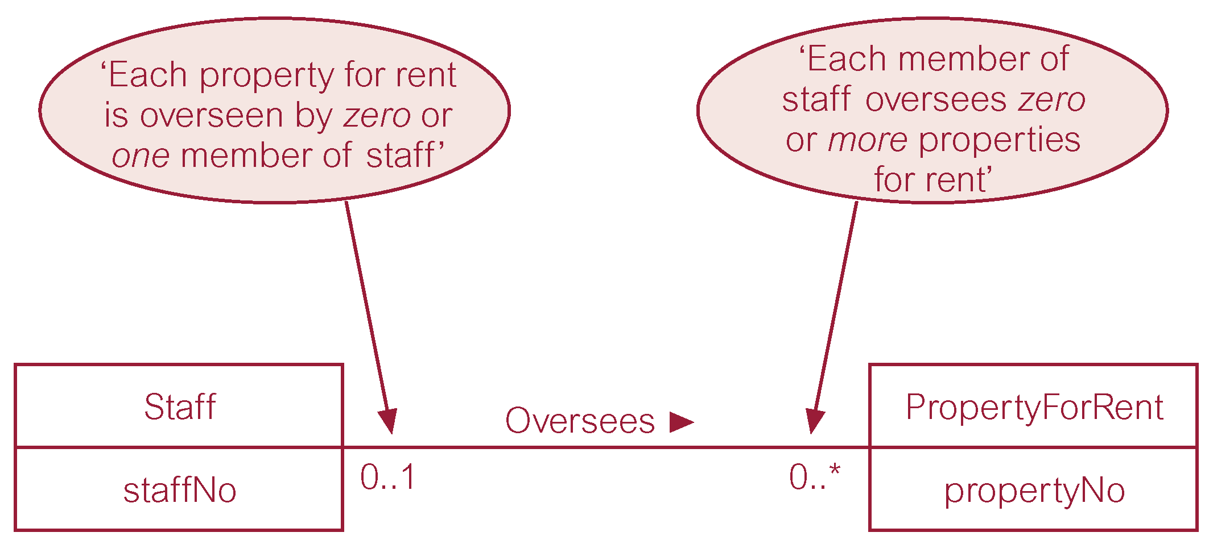
Semantic net of Staff Oversees PropertyForRent relationship type
Multiplicity of Staff Oversees PropertyForRent (1:*) relationship type
© Pearson Education Limited 1995, 2005

Slide 39
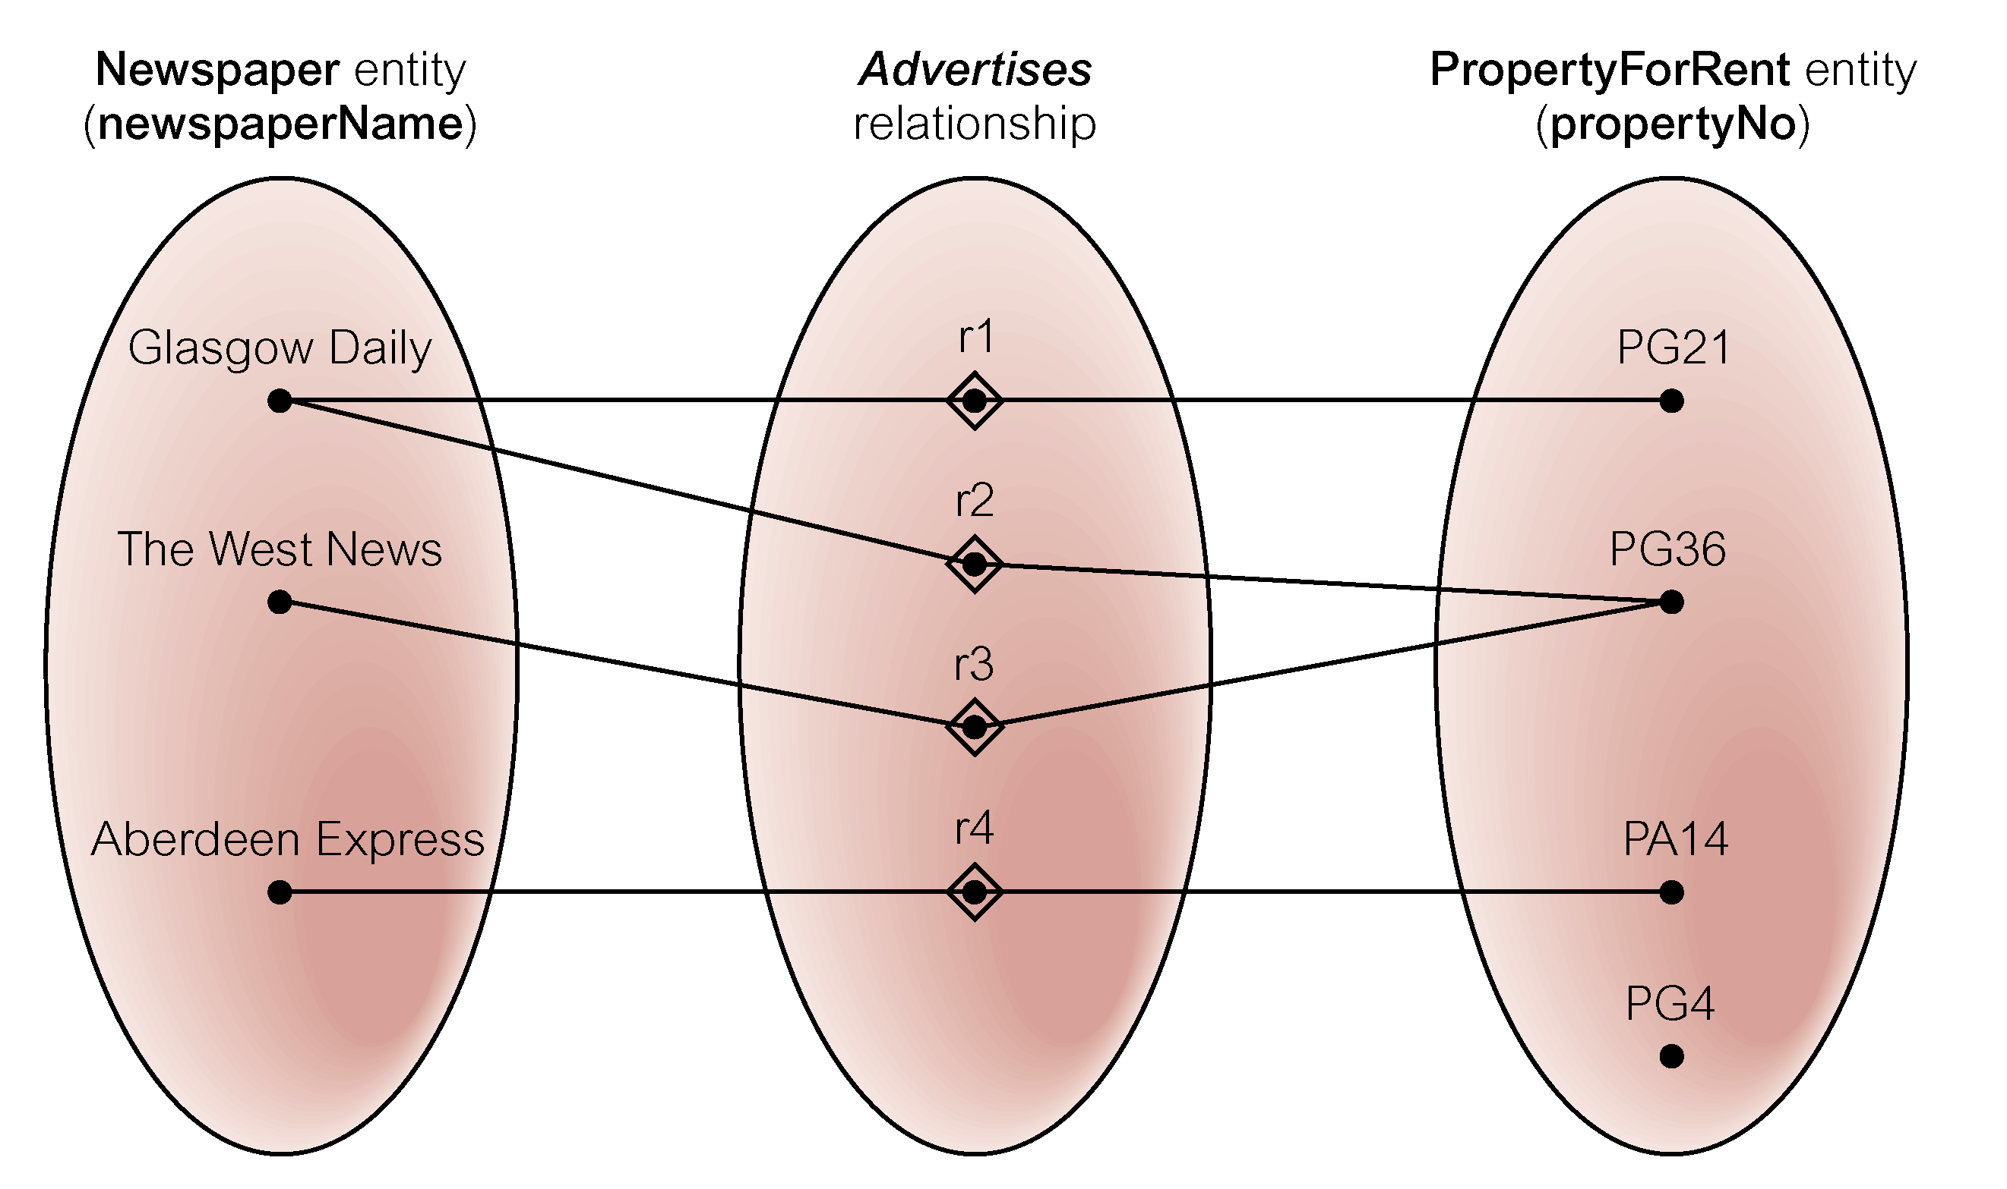
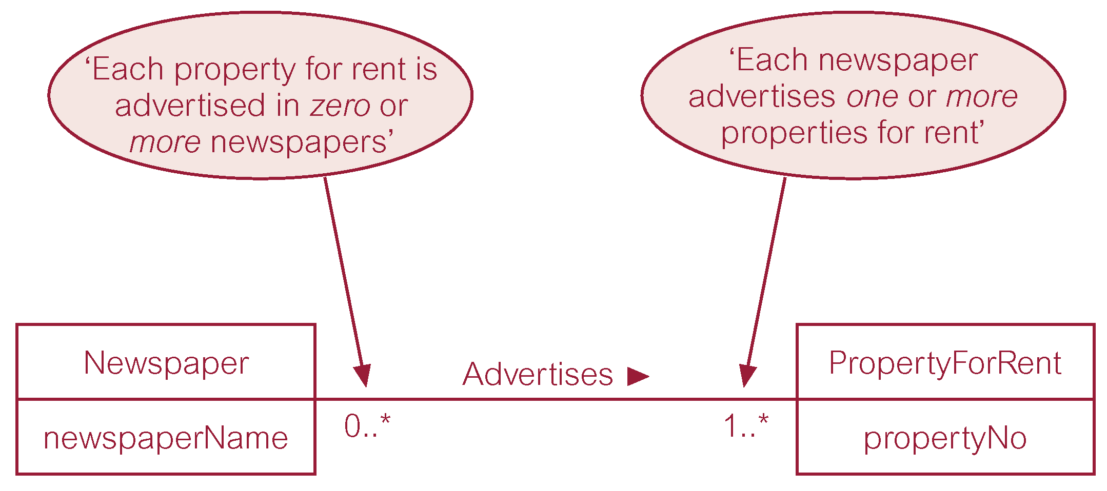
Semantic net of Newspaper Advertises PropertyForRent relationship type
Multiplicity of Newspaper Advertises PropertyForRent (*:*) relationship
© Pearson Education Limited 1995, 2005

Slide 40
Cardinality Constraints
Cardinality binary relationship between entity set X and Y:
  One-to-One (1:1)
  One-to Many (1:*)
  Many-to-one (*:1)
  Many-to-Many (*:*)

Slide 41
Cardinality Constraints
x₁
y₁
x₁
y₁
x₂
y₂
x₂
y₂
x₃
y₃
x₃
y₃
y₄
One to One (1:1)
One to Many (1:M)

Slide 42
Cardinality Constraints
x₁
y₁
x₁
y₁
x₂
x₂
y₂
x₃
x₃
y₃
x₄
y₂
x₄
y₄
Many to One (M:1)
Many to Many (M:M)

Slide 43
Relationship Participation
Optional participation
  One entity occurrence does not require corresponding entity occurrence in particular relationship
Mandatory participation
  One entity occurrence requires corresponding entity occurrence in particular relationship
Database Systems, 8th Edition

Slide 44
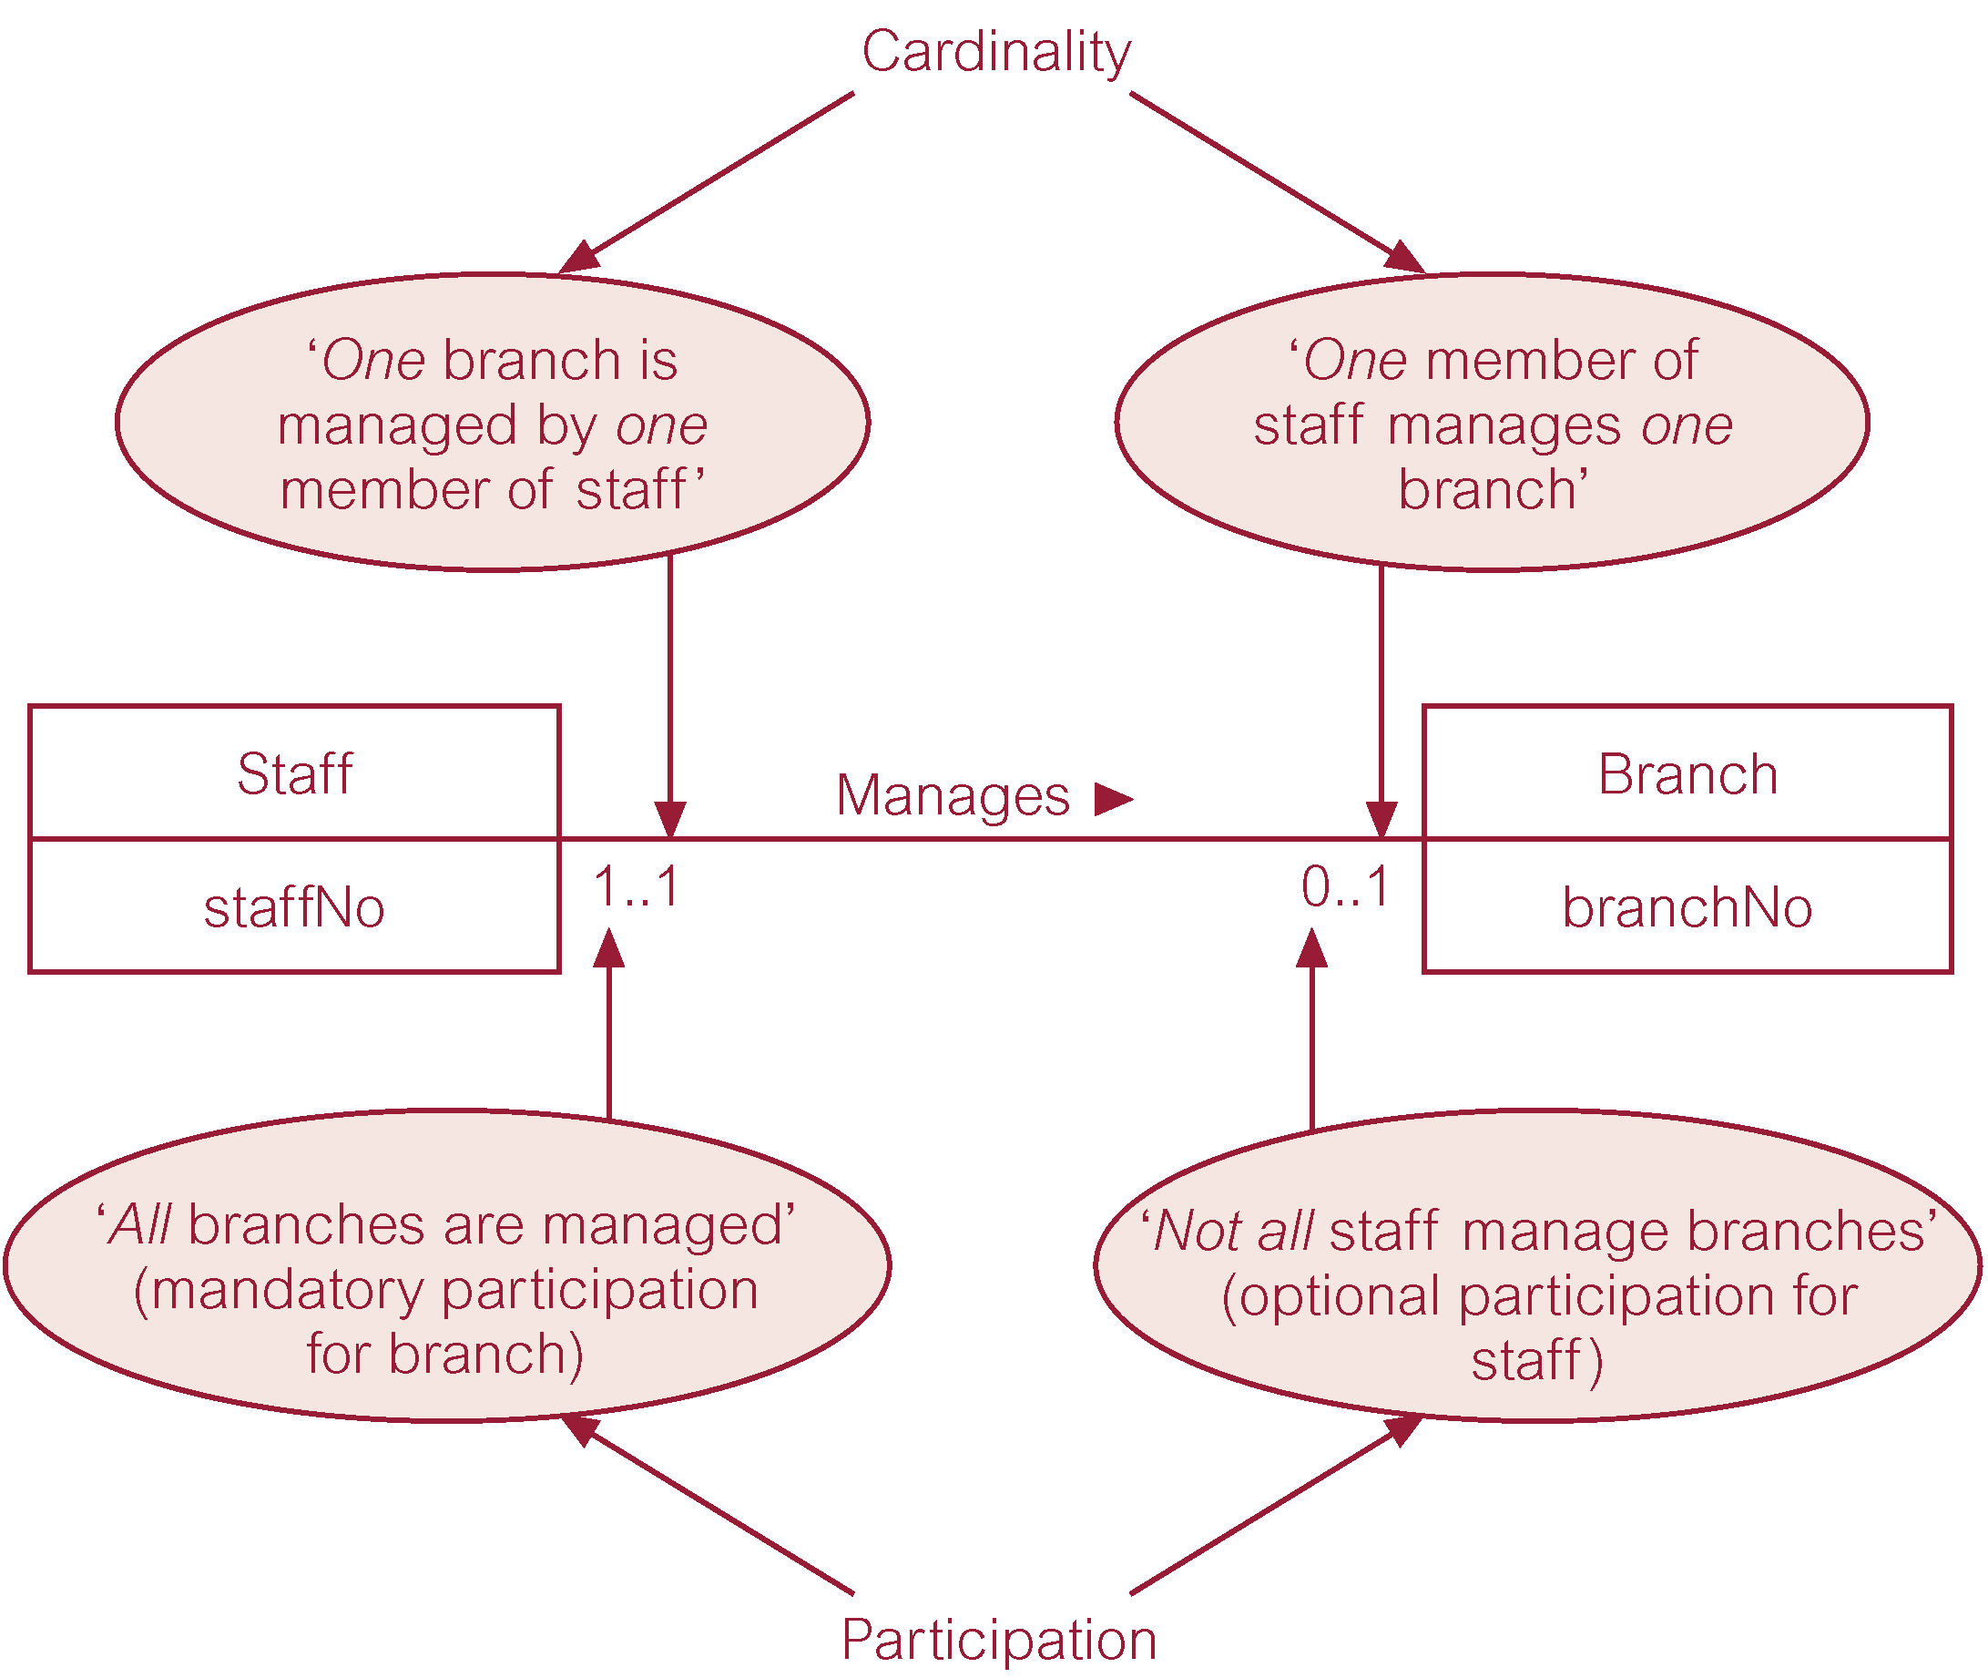
Multiplicity as cardinality & participation constraints
Cardinality Constraints
Minimum Cardinality
  If zero, then optional
  If one or more, then mandatory
Maximum Cardinality
  The maximum number
© Pearson Education Limited 1995, 2005

Slide 45
Relationship Participation
Staff is mandatory to Branch
Branch is optional to Staff

Slide 46
Descriptive Attributes
Also known as bridge/associative entities
Used to implement M:N relationships
Composed of primary keys of each of the entities to be connected
May also contain additional attributes that play no role in connective process
Database Systems, 8th Edition

Slide 47
The M*M relationship between Student and Course
Student
Course
Register
studentID (PK)
name
department
1..*
1..*
courseCode (PK)
unit
The Composite entity in an ERD
Student
Register
Course
studentID (PK)
name
department
1..*
1..*
courseCode (PK)
unit
date

Slide 48
Chapter 3:
Business Rules
BCI2023 – DATABASE SYSTEMS

Slide 49
Business Rules
Descriptions of policies, procedures, or principles within a specific organization
  Apply to any organization that stores and uses data to generate information
Description of operations to create/enforce actions within an organization’s environment
Used to define:
  Entities
  Attributes
  Relationships
  Constraints

Slide 50
Business Rules (2) – A good business rules is…
Must be in writing and kept up to date
Widely disseminated
Describe characteristics of data as viewed by the company
Declarative–what, not how
Precise–clear, agreed-upon meaning
Atomic–one statement
Consistent–internally and externally
Expressible–structured, natural language
Distinct–non-redundant
Business-oriented–understood by business people

Slide 51
Business Rules (3)
Example of business rules:
  A customer may generate many invoices
  An invoice is generated by only one customer
  A training session cannot be scheduled for fewer than 10 employees or more than 30 employees

Slide 52
Business Rules (5)
Teach
Lecturer
Course
1..1
0..1
A Lecturer may teaches one Course
A Course is taught by only one Lecturer

Slide 53
Business Rules (5)
Sources of business rules:
  Company managers
  Policy makers
  Department managers
  Written documentation
    Procedures
    Standards
    Operations manuals
  Direct interviews with end users
Database Systems, 8th Edition

Slide 54
Discovering Business Rules (continued)
Standardize company’s view of data
Communications tool between users and designers
Allow designer to understand the nature, role, and scope of data
Allow designer to understand business processes
Allow designer to develop appropriate relationship participation rules and constraints
Database Systems, 8th Edition

Slide 55
Developing an ER Diagram
Database design is an iterative process
  Create detailed narrative of organization’s description of operations
  Identify business rules based on description of operations
  Identify main entities and relationships from business rules
  Develop initial ERD
  Identify attributes and primary keys that adequately describe entities
  Revise and review ERD
Database Systems, 8th Edition

Slide 56
Example: University of Engineering & Technology

Slide 57
Example: UET
Business Rule 1:
  UET consists of a few departments that are lead by their own heads of department. Each department consists of few lecturers to teach certain courses. All courses offered are centralized by the university.
HeadDept
Lead
Department
Hire
Lecturer
1
1
1
*

Slide 58
Example: UET
Business Rule 2:
  Every lecturer is required to teach up to 3 courses every semester but exception may be given to lecturers that have been assigned to other tasks. Each course can only be taught by one lecturer only but can be taken by many students. There are courses that require 2 pre-requisites but most courses do not require any pre-requisite.

Slide 59
Example: UET
Business Rule 2
Prerequisite
Become
Require
Student
0..*
Course
0..2
Lecturer
Register
Teach
0..*
2..5
0..3
1..1

Slide 60
Example: UET
Business Rule 3:
  It is compulsory for every lecturer to declare their properties so that it can be stored in the database.
Lecturer
Declare
Property
1..1
0..*

Slide 61
Example: UET
Business Rule 4:
  All head of departments and lecturers are encouraged to become the member of the university welfare club.
HeadDept
MemberOf
Club
MemberOf
Lecturer
0..*
1..1
1..1
0..*

Slide 62
HeadDept
MemberOf
Club
0..*
1..1
1
1..1
Lead
MemberOf
1
0..*
Department
Hire
Lecturer
Declare
Property
1
*
1..1
0..*
1
1..1
Has
Teach
*
0..3
Student
Register
Course
Become
0..*
2..5
0..*
Prerequisite
0..2
Require

Slide 63
Summary
Entity relationship (ER) model
  Uses ERD to represent conceptual database as viewed by end user
  ERM’s main components:
    Entities
    Relationships
    Attributes
  Includes connectivity and cardinality notations
Database Systems, 8th Edition

Slide 64
Summary (continued)
Connectivities and cardinalities are based on business rules
M:N relationship is valid at conceptual level
  Must be mapped to a set of 1:M relationships
ERDs may be based on many different ERMs
Database designers are often forced to make design compromises
Database Systems, 8th Edition

